Slide 1
OPERATING SYSTEM Process and Process Context
Notes:
1

Slide 2
What is a Process ?
A program in execution.
A process includes program's instructions and data, program counter and all CPU's registers, process stacks containing temporary data.
Each individual process runs in its own virtual address space and is not capable of interacting with another process except through secure, kernel managed mechanisms.

Slide 3
process
The process is one of the fundamental abstraction in Linux operating system
Processes provide two virtualizations: a virtualized processor and virtual memory

Slide 4
Algorithms, Programs, and Processes
Idea
Execution Engine
Files
Files
Algorithm
Files
Status
Stack
Source
Program
Binary
Program
Data
Other
Resources
Process

Slide 5
Processes
Process make things happen in Linux
A process is the execution of a program(instance of running program)
A process is consists of text (machine code), data and stack
A process is said to be born when the program starts execution and remains alive as long as the program is active.
Kernel is responsible for management of process.

Slide 6
Process
Many process can run simultaneously as kernel schedules them for execution
Several processes may be instances of one program
A process reads and writes its data and stack sections, but it cannot read or write the data and stack of other processes
A process communicates with other processes and the rest of the world via system calls

Slide 7
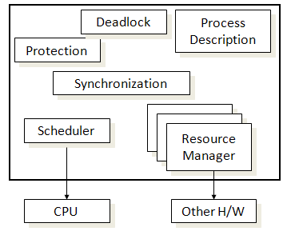
Process manager

Slide 8
When a process is created, the process manager algorithm creates a data structure to keep all the details it requires for managing the process.
The process descriptor is the data structure where the OS will keep all information it needs to manage that process.
What information should be kept in a process descriptor ?

Slide 9
Process descriptor
Process id | Internal name of the process
state | Process’s current state
owner | Process owner.
threads | List of threads associated with this process
List of related process | List of sibling process
List of child process | A reference to list of child of this process
Address space | A description of the address space and its binding
stack | Location of the stack in the memory

Slide 10
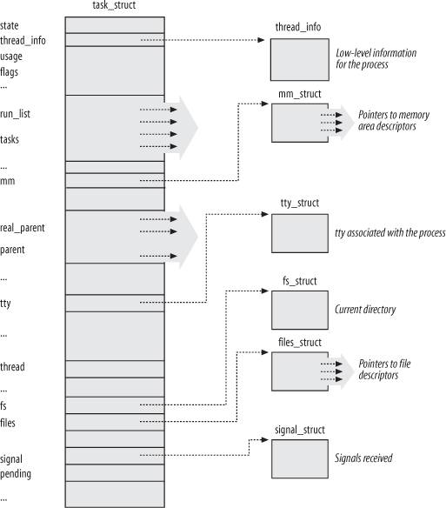
Linux Process Descriptor
Notes:
Execution of the collection of tasks - Managed by the Linux kernel
Struct task_struct is created when a process is created and it is “tied” into the list of tasks

Slide 11
State of a Process
State Variable - summary status of the process/thread which is located in descriptor
Request
Simple State Diagram
Done
Running
Request
Schedule
Allocate
Start
Blocked
Ready
Notes:
Transitions from one state to another
Running - request -> either get resource & continue running or not get resource & block

Slide 12
Process State
stopped
creation
signal
signal
executing
termination
zombie
ready
scheduling
suspended
input / output
end of
input / output

Slide 13
Process management
The process manager creates the environment in which multiple processes co-exist, each with own abstract machine
When hardware process begin to execute OS code, it will execute an algorithm that switches the hardware process from one context to another
These Context switches can occur when ever OS gets control of the processor.

Slide 14
Process context
The context of a process consists of the contents of its (user) address space and the contents of hardware registers and kernel data structures that relate to the process.
Formally, the context of a process is the union of its user-level context ; register context , and system -level context .
The user-level context consists of the process
text, data, user stack, and shared memory that occupy the virtual address space of the process.

Slide 15
Register context
The register context consists of the following component
The program counter specifies the address of the next instruction the CPU will execute;
The processor status register (PS) specifies the hardware status of the machine as it relates to the process.
The stack pointer contains the current address of the next entry in the kernel or user stack, determined by the mode of execution.
The general-purpose registers contain data generated by the process during its execution.

Slide 16
Context Switch
When the kernel decides that it should execute another process, it does a context switch, so that the system executes in the context of the other process
When doing a context switch, the kernel saves enough information so that it can later switch back to the first process and resume its execution.
the kernel saves the context of a process whenever it pushes a new system context layer.

Slide 17
Context Switching
Old process
Descriptor
CPU
New process Descriptor

Slide 18
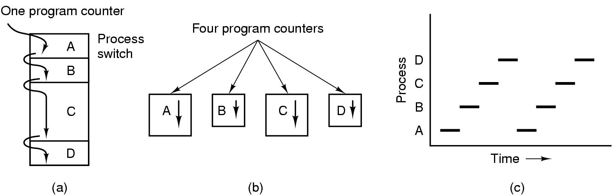
Multiprogramming
(a) Multiprogramming of four programs. (b) Conceptual model of four independent, sequential processes. (c) Only one program is active at once.

Slide 19
Process Creation and Execution
UNX process management separates the creation of processes and the running of a new program into two distinct operations.
The fork system call creates a new process.
A new program is run after a call to execv.

